Slide 1
The Restriction Scaffold Problem
J. Comput. Biol. 10(2) (2003) 385-398
Amir Ben-Dor, Richard M. Karp, Benno Schwikowski, Ron Shamir
Presenter: Jen-Hui Wang
Date: May 18, 2006

Slide 2
An Assignment Problem
G = {g₁, g₂, · · · g_{t}}, B = {b₁, b₂, · · · b_{s}}, t ≥ s
Find
Q: cost function
F assigns every girl to exactly one boy, and every boy to at least one girl

Slide 3
An Assignment Problem
Two-stage process:
Stage 1: Matching
=> Linear-Cost Matching
Stage 2: Assigning the Unmatched Girls
=> Q(g_{i}, b_{k}) = min_{j} Q(g_{i}, b_{j} )

Slide 4

Linear-Cost Matching Algorithm
Sort S in increasing order of position and determine the level of each element
Within each level, determine a matching of minimum cost in which each girl is matched with at most one boy and each boy is matched with exactly one girl
Construct the union of the matchings at the different levels

Slide 5
Example
Sort S in increasing order of position and determine
the level of each element

Slide 6
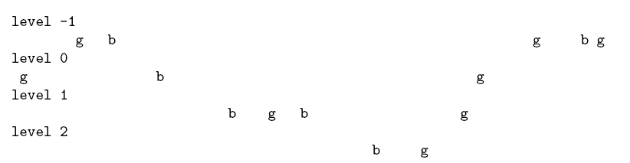
Example
Boys and girls separated by level

Slide 7
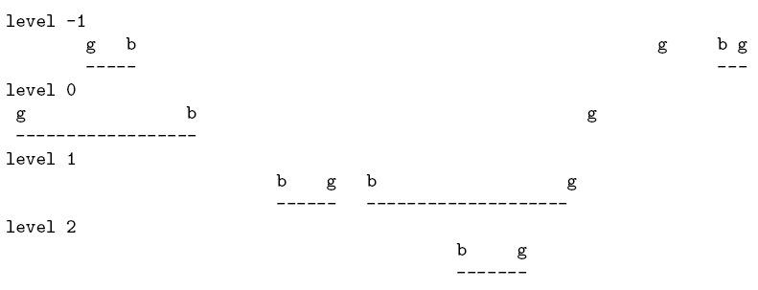
Example
Optimal matching in each level

Slide 8

Example
Optimal overall matching

Slide 9
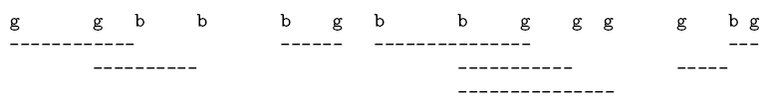
Example
Optimal assignment after completion of Stage 2

Slide 10
Time Complexity
Sort S in increasing order of position and determine the level of each element
Within each level, determine a matching of minimum cost in which each girl is matched with at most one boy and each boy is matched with exactly one girl
Construct the union of the matchings at the different levels
Step 1: O(nlogn)
Step 2 & 3: O(n)
Total: O(nlogn)

Slide 11
Counterexample
G = {0,2,7,12}, B = {1,4,11}
=> S = {0,1,2,4,7,11,12}
determine the level of each element
g(0)
b(1)
g(2)
b(4)
g(7)
b(11)
g(12)
0
0
0
0
0
0
0

Slide 12
Counterexample
Optimal matching in each level
g(0)
b(1)
g(2)
b(4)
g(7)
b(11)
g(12)
Optimal assignment after completion of Stage 2
g(0)
b(1)
g(2)
b(4)
g(7)
b(11)
g(12)

Slide 13
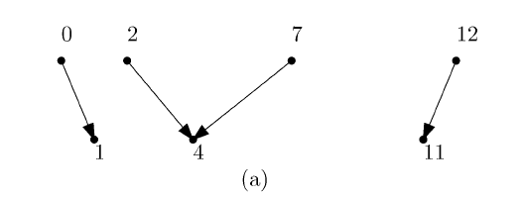
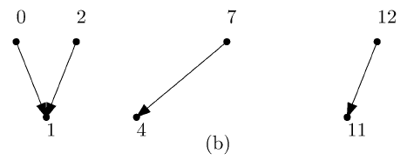
Counterexample
Result
The minimal assignment

